Slide 1
Identification of Different Medicinal Plants/Raw materials through ImaIdentificationge Processing Using Machine Learning Algorithms
PIP4001 Capstone Project
Review-1
Batch Number: COM-11
ROLL NUMBER | STUDENT NAME
20211COM0063 | K C VINDYA
20211COM0082 | RUSHAB A R
20211COM0074 | NIKHIL S
20211COM0084 | MUKESH K A
Under the Supervision of,
Dr. Pajany M
Assistant Professor - SCSE
School of Computer Science and Engineering
Presidency University
Name of the Program: Computer Engineering
Name of the HoD: Dr. Gopal Krishna Shyam
Name of the Program Project Coordinator: Dr. Sudha P
Name of the School Project Coordinators: Dr. Sampath A K Associate Professor (SG), Dr. Abdul Khadar A Associate Professor, Mr. MD ZIAUR RAHMAN

Slide 2
Introduction
India has a rich history of traditional medicine, with Ayurveda relying heavily on medicinal plants and raw materials. However, the accurate identification of these plants remains a challenge due to similar morphological traits, seasonal and geographical variations, and widespread adulteration. Misidentification can lead to compromised efficacy and reduced trust in Ayurvedic pharmaceuticals.
This project aims to develop a software solution leveraging image processing and machine learning algorithms to ensure accurate identification and differentiation of medicinal plants. By automating the recognition process, this system enhances quality control, ensures authenticity, and strengthens the overall supply chain in the herbal medicine industry.

Slide 3
Literature Review
1. Jain et al. (2000) – Reviews statistical pattern recognition techniques, discussing classification, feature extraction, and applications in AI and machine learning.
2. LeCun et al. (2017) – Introduces deep learning, explaining neural network architectures like CNNs, RNNs, and their applications in image and speech recognition.
3. Ren et al. (2017) – Proposes Faster R-CNN, an advanced object detection framework that integrates region proposal networks for improved speed and accuracy.
4. Long et al. (2017) – Develops fully convolutional networks (FCNs) for semantic segmentation, enabling pixel-wise classification for detailed image understanding.
5. Simonyan & Zisserman (2016) – Introduces the VGG network, demonstrating how deeper convolutional networks improve large-scale image recognition tasks.

Slide 4
Literature Review (continued)
6. Szegedy et al. (2016) – Presents the Inception model, optimizing deep learning efficiency by factorizing convolutions and reducing computational complexity.
7. Hinton et al. (2007) – Describes deep belief networks (DBNs), using layer-wise pretraining to improve deep learning model convergence and performance.
8. Krizhevsky et al. (2017) – Introduces AlexNet, a deep CNN model that significantly advanced image classification by using ReLU activation and GPU acceleration.
9. Lowe (2004) – Proposes the Scale-Invariant Feature Transform (SIFT), a robust feature detection algorithm resistant to changes in scale, rotation, and illumination.
10. Everingham et al. (2010) – Discusses the Pascal VOC Challenge, a benchmark dataset for evaluating object detection, segmentation, and classification models.

Slide 5
Existing method Drawback
Author(s) | Drawback
A. K. Jain, P. W. Duin, J. Mao | Lacks coverage of modern deep learning approaches.
Y. LeCun, Y. Bengio, G. Hinton | Computationally expensive & requires large datasets.
S. Ren, K. He, R. Girshick, J. Sun | Computationally intensive for real-time applications.
J. Long, E. Shelhamer, T. Darrell | Requires large-scale annotated datasets.
K. Simonyan, A. Zisserman | High memory & computational cost.
C. Szegedy, W. Liu, Y. Jia, et al. | Complex architecture makes training harder.
G. E. Hinton, S. Osindero, Y. W. Teh | Not as effective as modern CNNs & Transformers.
A. Krizhevsky, I. Sutskever, G. E. Hinton | Requires extensive training data & high GPU power.
D. G. Lowe | Computationally expensive compared to modern alternatives.
M. Everingham, L. Van Gool, C. K. I. Williams, et al. | Limited object categories compared to newer datasets.

Slide 6
Proposed Method
Image Acquisition & Preprocessing:
Collect high-quality images of medicinal plants.
Apply resizing, augmentation, and noise reduction.
Feature Extraction:
Use SIFT, CNN, or ResNet for extracting unique plant features.
Classification Model:
Train a CNN-based deep learning model for plant identification.
Fine-tune using transfer learning (VGG, Inception).
Authentication & Adulteration Detection:
Use pattern recognition and machine learning models (SVM, Random Forest) to classify genuine vs. adulterated plants.
Performance Optimization:
Evaluate using Precision, Recall, F1-score, and mAP.
Optimize with hyperparameter tuning and transfer learning.
Deployment:
Implement as a mobile or web app for real-time plant identification.
Use Edge AI for offline predictions in remote areas.

Slide 7
Objectives
To develop a software solution for the accurate identification of medicinal plants using image processing and machine learning.
To create a dataset of medicinal plants with labeled images for training the model.
To classify medicinal plants based on morphological features such as leaf shape, texture, and color.
To minimize adulteration and misidentification in the Ayurvedic pharmaceutical industry.
To enhance supply chain transparency by providing an authentication system for raw materials.

Slide 8
Methodology
1. Data Collection:
Gathering high-quality images of medicinal plants from verified sources.
Ensuring diversity in images by capturing various angles, lighting conditions, and seasonal variations.
2. Image Preprocessing:
Noise reduction and background removal.
Resizing and normalization for uniformity.
Color correction and feature extraction.
3. Feature Extraction:
Analyzing morphological features like leaf shape, venation, texture, and color distribution.
Extracting key descriptors using edge detection, contour analysis, and histogram methods.

Slide 9
Methodology (continued)
4. Machine Learning Model Training:
Using CNN (Convolutional Neural Networks) for image classification.
Training and testing models on labeled datasets.
Fine-tuning hyperparameters for accuracy improvement.
5. Model Validation and Testing:
Performance evaluation using accuracy, precision, recall, and F1-score.
Comparing results with existing plant identification methods.
6. Deployment and Integration:
Developing a user-friendly interface for farmers, researchers, and Ayurvedic manufacturers.
Cloud-based or mobile application implementation for accessibility.

Slide 10
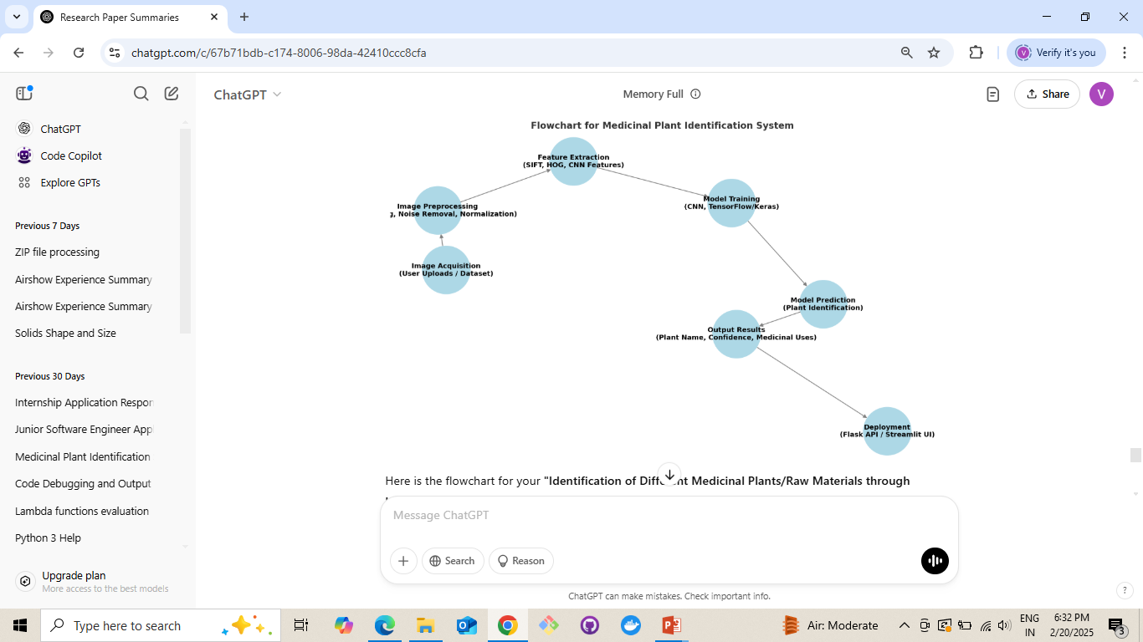
Architecture

Slide 11
Software components
1. Programming Language & Development Environment
Python – Due to its strong machine learning and image processing libraries.
2. Image Processing & Computer Vision Libraries
OpenCV – For image pre-processing, feature extraction, and transformation.
3. Machine Learning & Deep Learning Libraries
TensorFlow – For building deep learning models (CNNs).
PyTorch – Alternative to TensorFlow for deep learning tasks.
scikit-learn – For ML model training, classification, and validation.
4. Dataset Handling & Annotation
Pandas & NumPy – For dataset management and manipulation.
LabelImg – For annotating images if dataset labeling is required.
5. Model Deployment & Integration
Flask / FastAPI – To create a web-based API for plant identification.
6. Database for Storing Plant Data (Optional)
SQLite / MySQL – To store medicinal plant details and classification results.

Slide 12
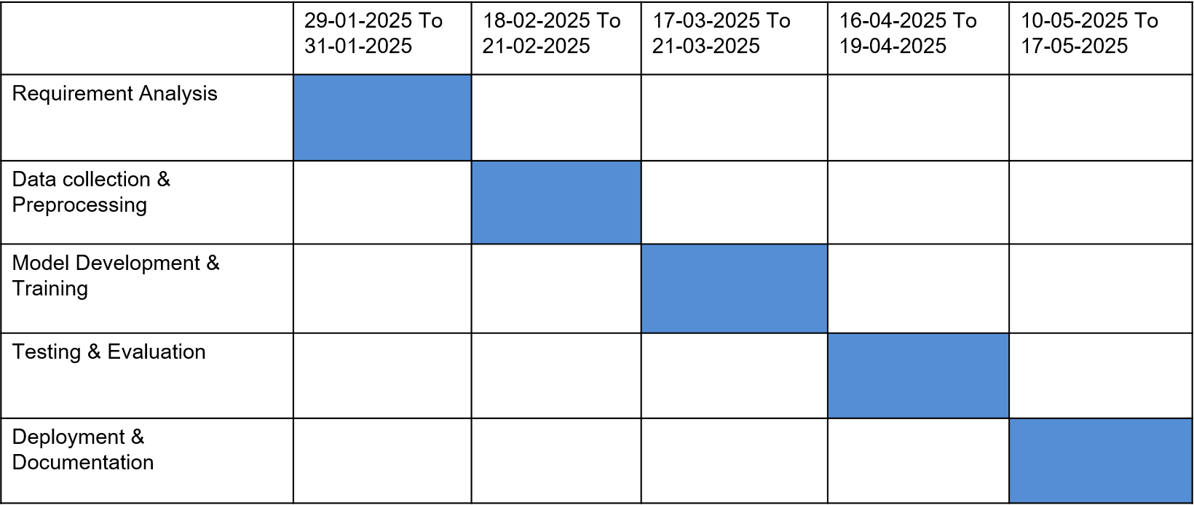
Timeline of Project

Slide 13
Expected Outcomes
A software tool capable of accurately identifying medicinal plants based on images.
A robust dataset for future research and training of AI models in herbal medicine.
Reduction in misidentification and adulteration of medicinal plant raw materials.
Improved quality control in the Ayurvedic pharmaceutical supply chain.
Increased trust and confidence among consumers and manufacturers in traditional medicine.

Slide 14
Conclusion
This project aims to bridge the gap between traditional knowledge and modern technology by integrating machine learning and image processing for medicinal plant identification. By ensuring authenticity, this system has the potential to revolutionize the Ayurvedic industry, supporting sustainable herbal medicine practices and fostering innovation in plant-based healthcare.

Slide 15
References
[1] A. K. Jain, P. W. Duin, and J. Mao, "Statistical Pattern Recognition: A Review," IEEE Transactions on Pattern Analysis and Machine Intelligence, vol. 22, no. 1, pp. 4-37, 2000.
[2] Y. LeCun, Y. Bengio, and G. Hinton, "Deep Learning," IEEE Transactions on Neural Networks and Learning Systems, vol. 28, no. 2, pp. 1-17, 2017.
[3] S. Ren, K. He, R. Girshick, and J. Sun, "Faster R-CNN: Towards Real-Time Object Detection with Region Proposal Networks," IEEE Transactions on Pattern Analysis and Machine Intelligence, vol. 39, no. 6, pp. 1137-1149, 2017.
[4] J. Long, E. Shelhamer, and T. Darrell, "Fully Convolutional Networks for Semantic Segmentation," IEEE Transactions on Pattern Analysis and Machine Intelligence, vol. 39, no. 4, pp. 640-651, 2017.
[5] K. Simonyan and A. Zisserman, "Very Deep Convolutional Networks for Large-Scale Image Recognition," IEEE Transactions on Neural Networks and Learning Systems, vol. 27, no. 1, pp. 1-14, 2016.

Slide 16
REFERENCES(continued)
[6] C. Szegedy, W. Liu, Y. Jia, et al., "Going Deeper with Convolutions," IEEE Transactions on Pattern Analysis and Machine Intelligence, vol. 38, no. 1, pp. 1-12, 2016.
[7] G. E. Hinton, S. Osindero, and Y. W. Teh, "A Fast Learning Algorithm for Deep Belief Nets," IEEE Transactions on Neural Networks, vol. 18, no. 3, pp. 1-13, 2007.
[8] A. Krizhevsky, I. Sutskever, and G. E. Hinton, "ImageNet Classification with Deep Convolutional Neural Networks," IEEE Transactions on Neural Networks and Learning Systems, vol. 25, no. 1, pp. 1-9, 2017.
[9] D. G. Lowe, "Distinctive Image Features from Scale-Invariant Keypoints," IEEE Transactions on Pattern Analysis and Machine Intelligence, vol. 26, no. 1, pp. 1-18, 2004.
[10] M. Everingham, L. Van Gool, C. K. I. Williams, et al., "The Pascal Visual Object Classes (VOC) Challenge," IEEE Transactions on Pattern Analysis and Machine Intelligence, vol. 32, no. 9, pp. 1-15, 2010.

Slide 17
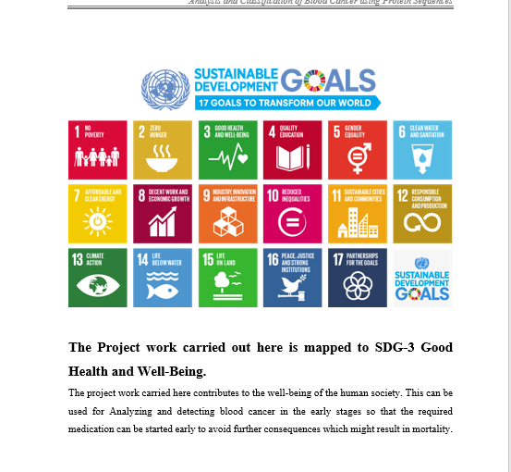
Project work mapping with SDG
SDG 3 (Good Health & Well-Being) – Supports herbal medicine research and enhances healthcare by identifying medicinal plants accurately.
SDG 9 (Industry, Innovation & Infrastructure) – Promotes innovation in AI and machine learning for medical and agricultural applications.
SDG 12 (Responsible Consumption & Production) – Encourages sustainable use of natural resources by improving the identification of medicinal plants.
SDG 15 (Life on Land) – Contributes to biodiversity conservation by identifying and preserving medicinal plant species.

Slide 18
Thank You

